Slide 1
Fast and Simple Algorithms to Count the Number of Vertex Covers in an Interval Graph
Min-Sheng Lin
Received 20 July 2006; received in revised form 30 November 2006
Information Processing Letters 102 (2007) 143–146
Presenter: Hsiang-I Weng
Date: Jan. 23, 2008

Slide 2
Abstract
This study provides the following fast and
simple algorithms for an interval graph:
(1) an algorithm for counting the number of
vertex covers
(2) an algorithm for counting the number of
minimal vertex covers.

Slide 3
Interval Graph
An undirected graph G is called an interval
graph if its vertices can be placed into a
one-to-one correspondence with a family I of
intervals on the real line such that two vertices
of G are connected by an edge if and only if the
corresponding intervals I of have a intersection.

Slide 4
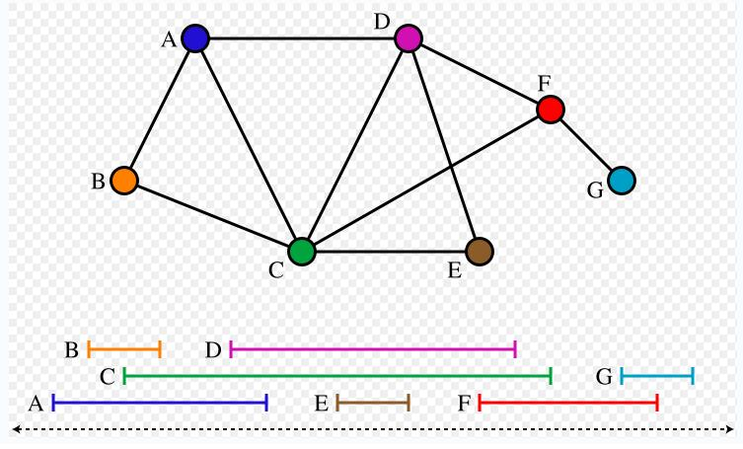
Seven intervals of the real line and the
corresponding seven-vertex interval graph.

Slide 5
An O(|V |)-time algorithm to count the number of vertex covers
Let I denote an interval representation of graph G = (V ,E) where |V| = n and V = {1, 2, . . . , n}.
the interval in I corresponding to vertex k in V is called interval k.
a(k) and b(k) represent the left and right endpoints of interval k
Without loss of generality, assume that no two intervals share a common endpoint.

Slide 6
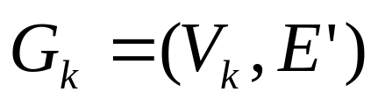
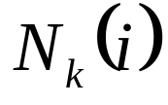




An O(|V |)-time algorithm to count the number of vertex covers
for two vertices i and j , b(i) < b(j) if and only if i < j.
Let is a subgraph of G
represents the neighborhood of vertex in .
represents the closed neighborhood of
vertex in .

Slide 7
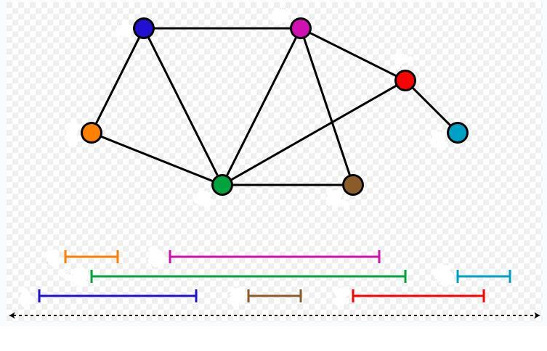
n=7
2
4
6
1
7
5
3
1
4
5
7
2
3
6
14

Slide 8
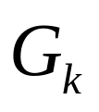

Algorithm Compute_x
Input: Interval Graph
Output:
x(0)←0; // initial condition //
h←0; // h is the rightmost interval for now //
for s←1 to 2n do
if s = a(k) then x(k)←h;
// s is the left end-point of interval k //
if s = b(k) then h←k;
// s is the right end-point of interval k //
end-for

Slide 9
n=7
2
4
6
1
7
5
3
1
4
5
7
2
3
6
14

Slide 10




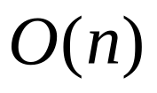
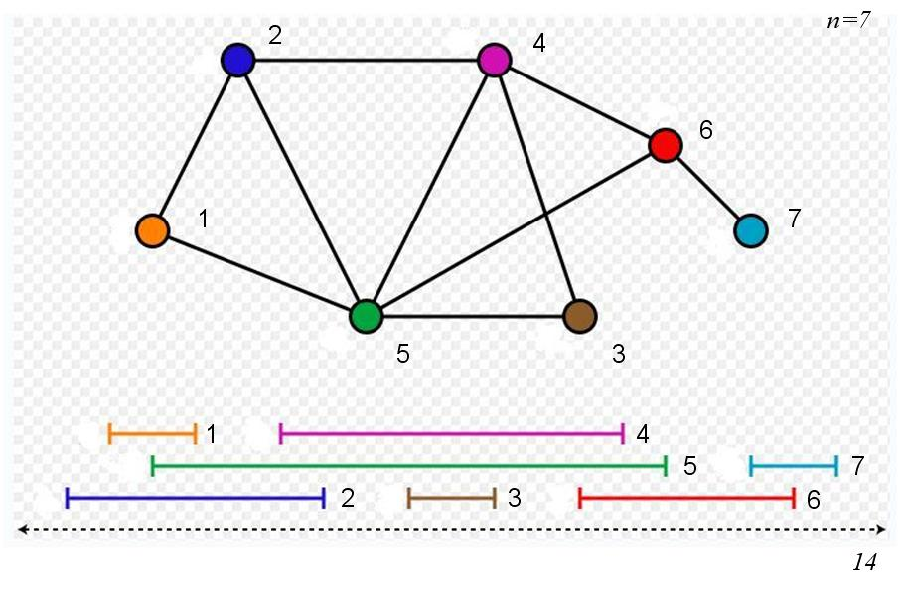
The number of vertex covers in an interval graph
Let denote the number of vertex covers in
Theorem 2.1.
For ,
time algorithm.

Slide 11


An O(|V |)-time algorithm to count the number of vertex covers
Input:
Output:
Algorithm Count_vc
begin
vc(0)←1; // initial condition //
for k←1 to n do
vc(k)←vc(k −1)+ vc(x(k));
// by Theorem 2.1 //
end-for
output(“the number of vertex cover is”, vc(n));
end-algorithm

Slide 13
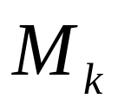

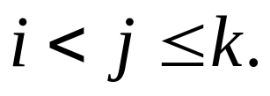
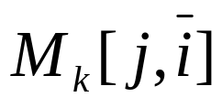
An O(|V |)-time algorithm to count the number of minimal vertex covers
Let denote the family of all minimal vertex cover sets in . For vertices i, j , and k with
let represent the set of all minimal vertex cover sets in including j but not including i.

Slide 14
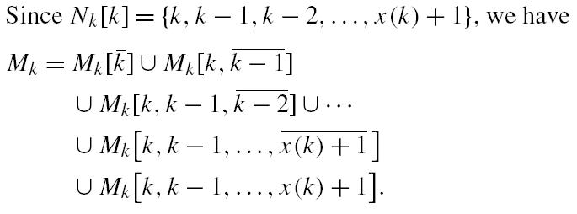
Family of all minimal vertex cover sets

Slide 15
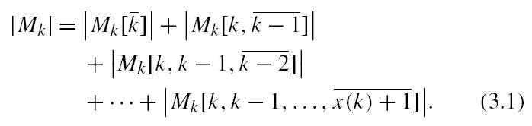
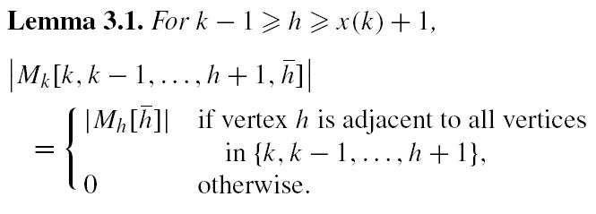
Family of all minimal vertex cover sets

Slide 16
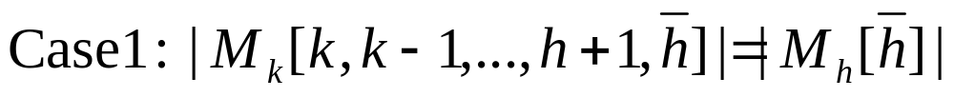
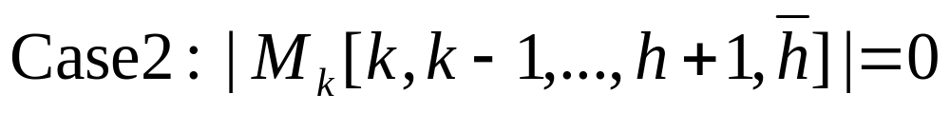
9
8
5
10
2
7
1
4
3
6
9
8
3
5
7
10
1
4
6
2

Slide 17
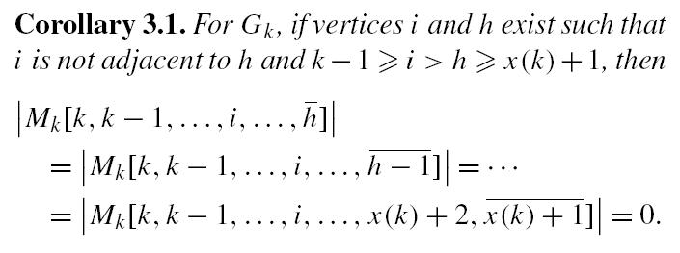
9
8
3
5
7
10
1
4
6
2

Slide 18
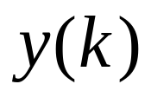
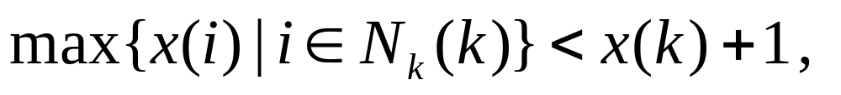
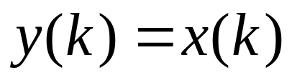
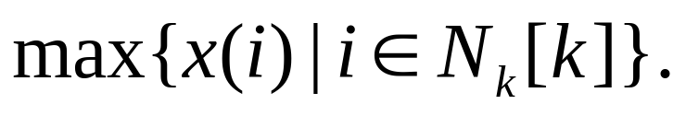
In particular, if no such exits, i.e.,
then
can be redefined as
Lemma 3.2.
9
7
3
5
8
1
4
6

Slide 19


Lemma 3.2.
Input:
Output:
Algorithm Compute_y
begin
y(0)←−1; // initial condition //
for k←1 to n do
if y(k −1) > x(k) then y(k)←y(k −1)
else y(k)←x(k); // by Lemma 3.3 //
end-for
end_algorithm

Slide 20
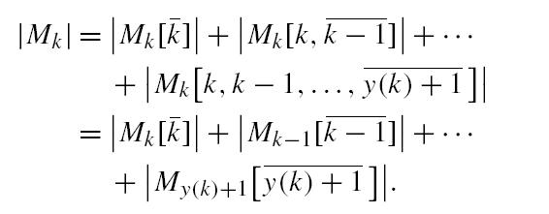
9
8
3
5
7
10
1
4
6
2
3
5
1
4
6
2

Slide 21


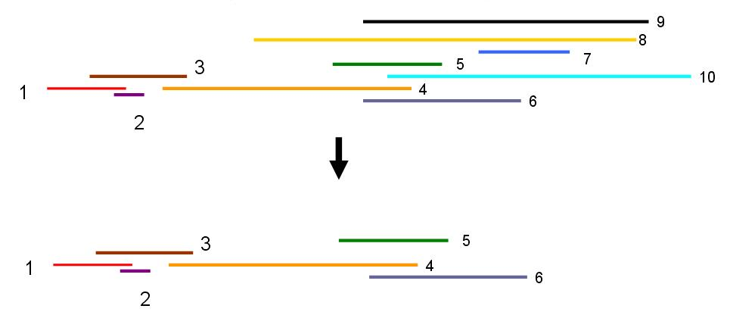
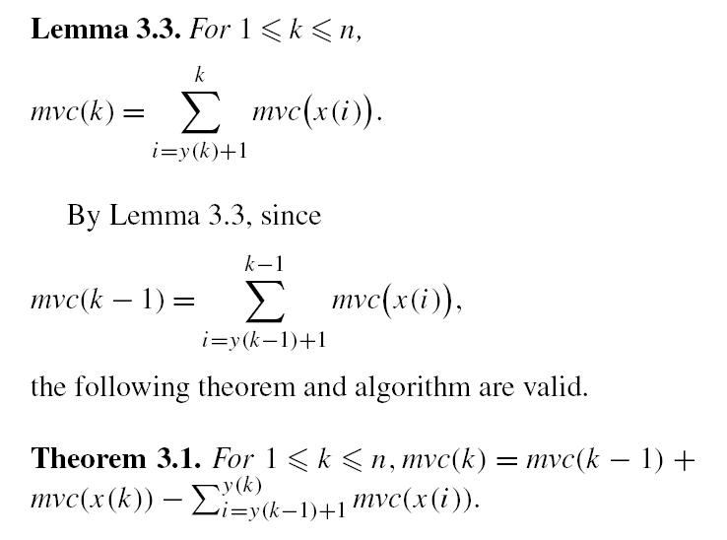
Let denote the cardinality of .

Slide 22
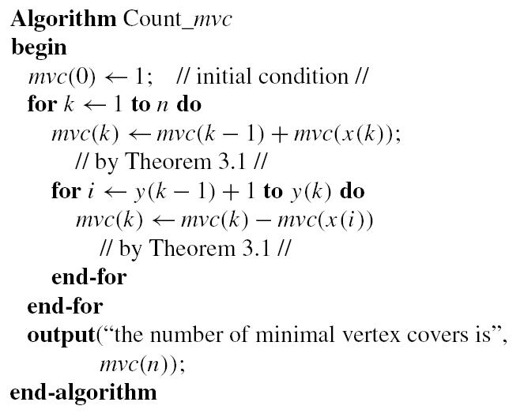

Slide 23
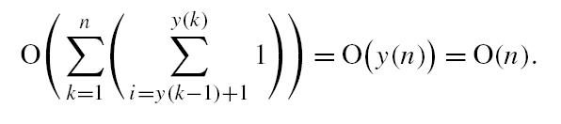
The computational complexity of the above algorithm is

